Slide 1

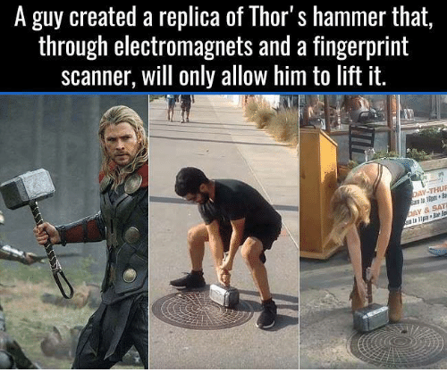
Magnetism and electricity day 4
9/29 & 9/30

Slide 2
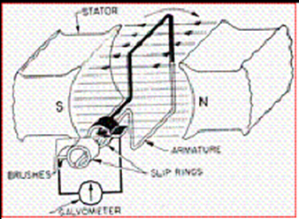
DQ
A college student designed and constructed a rotational/rotary electrical generator in his physics class to investigate cause and effect connections about magnetism and electricity.
Electromagnetic Induction
Rotational/Rotary Electrical Generator
When he first tested this generator, it only produced 50 amps. However, his goal was for this generator to induce 100 amps.
What is one action that he could do to make this happen?
a. | Remove the magnet | c. | Add an iron core
b. | Rotate the coil more quickly | d. | Use an electromagnet
STND: 8PS2.1 & 8ETS1.1

Slide 3
Kahoot review
Use this link if you are not in class to play with us. Kahoot
This is the 2nd Kahoot
STND: 8PS2.1 & 8ETS1.1

Slide 4
Quiz in Masteryconnect – Use the code given in class.
Email me for the code of you are not in class to take the quiz.
STND: 8PS2.1 & 8ETS1.1

Slide 5
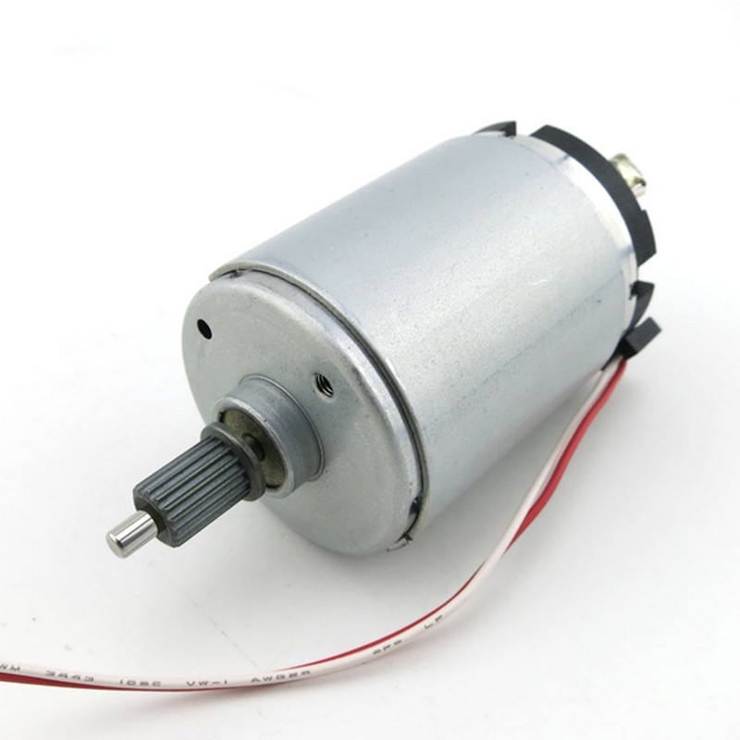
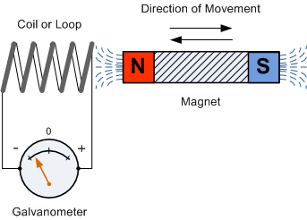
Build motors and generators without batteries
This Photo by Unknown Author is licensed under CC BY-SA
This Photo by Unknown Author is licensed under CC BY-SA
STND: 8PS2.1 & 8ETS1.1

Slide 6
Exit Ticket:
What is the difference between a generator and a motor?
STND: 8PS2.1
STND: 8PS2.1 & 8ETS1.1

